Slide 1




DIGITAL LITERACY
SKILLS
BASIC USERS

Slide 2

Module 5
Safety and security

Slide 3

4
Unit 4: Protecting the environment

Slide 4

Energy saving strategies
Buy energy efficient products
Buying energy-efficient products is a good way to save energy from the beginning.
Look for logos like the Energy Star to buy computer hardware that offers a good energy efficiency.
Some components come with extra energy saving features – be aware of what these are so that you can use these features.

Slide 5
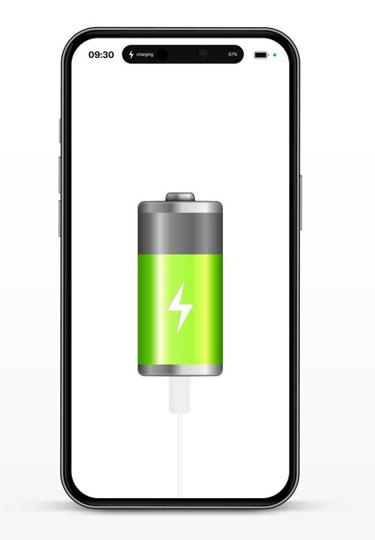
Use built-in power saving features
Most computer systems come with power saving features.
Try these tips to save energy:
Turn down the brightness.
Turn off the monitor instead of using a screensaver.
Disable devices that are not needed.
Turn off the computer.
Share hardware where appropriate.

Slide 6
Skills to practise
Save energy
Make a list of the electric devices in your home and community, for example, TVs, washing machines, computers, and laptops.
Note if any of these machines have a ‘standby mode’ – meaning that they stay on, ready to use even when not being used. You will often see a red light.
This means that all these machines are using electricity
Together with a friend, make a list of how you can remind others and yourself to rather switch off these machines to save electricity.

Slide 7
All back covers should include
contact information of the section
producing the work.
© United Nations Children’s Fund (UNICEF) [month and year of publication]

